Slide 1

Hello World
with itronics

Slide 2
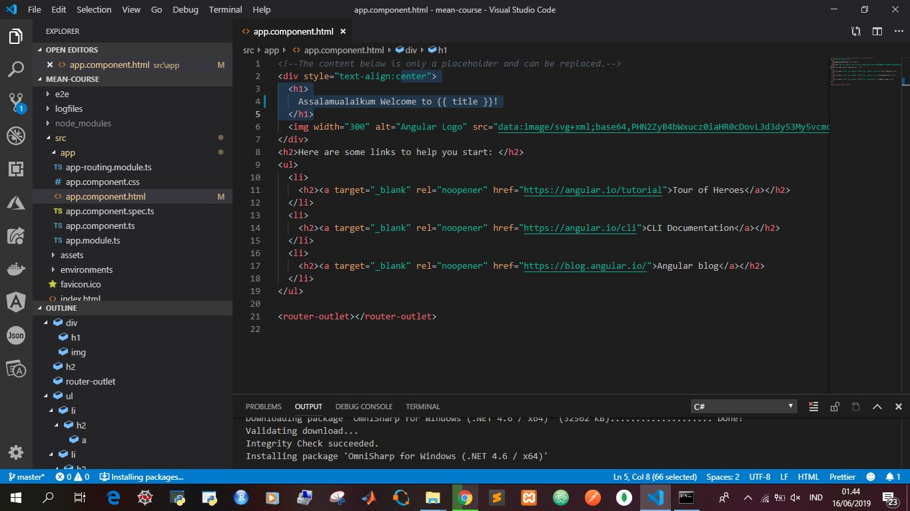
Open src>app>app.component.html then type <h1> Assalamualaikum (Hello World) to {{title}}! </h1>

Slide 3
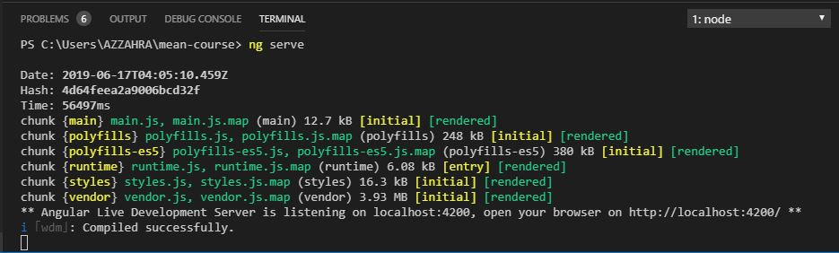
Setup live on browser by typing “ng serve” in visual studio code terminal

Slide 4
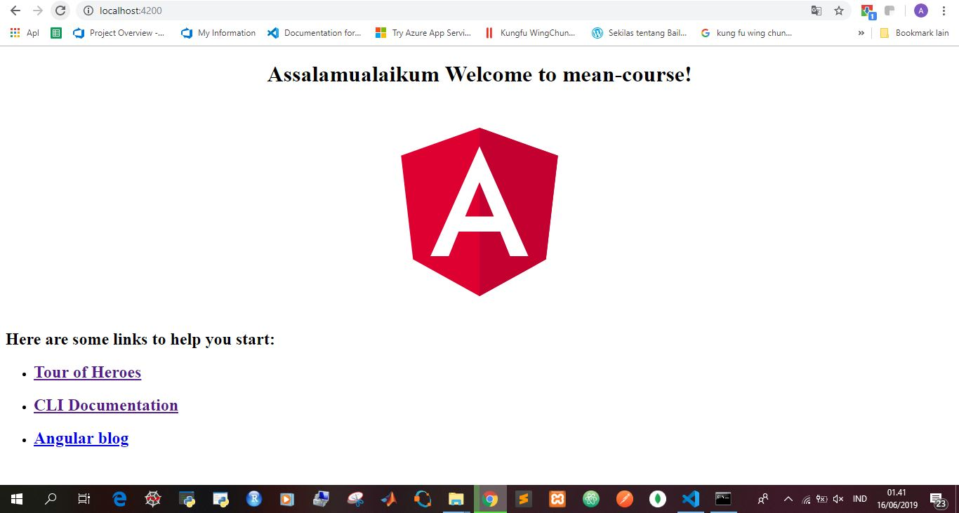
MEAN Hello World on Browser

